Slide 1
Trait-based approach
in community ecology
Day 4 — Fish morphological traits
& landmark measurements
FishMorph (Brosse et al. 2021) · 21 points · 11 measures · 10 ratios
Belém, Pará · Amazon, Brazil

Slide 2
Day 4 — Programme overview
THEORY
01
02
03
04
05
Why fish & FishMorph
Points to
Measurements
Measurements to
Traits
Reading each ratio biologically
ImageJ practical + R
Neotropical paradox · Brosse 2021 framework · 8,342 species
The standardised landmarking scheme · what to measure on each fish
FishMorph traits · locomotion + trophic + body size
Mouth, eye, fin, peduncle — what each value tells you about ecology
Hands-on measurement protocol · QC · FD on Amazonian fish

Slide 3
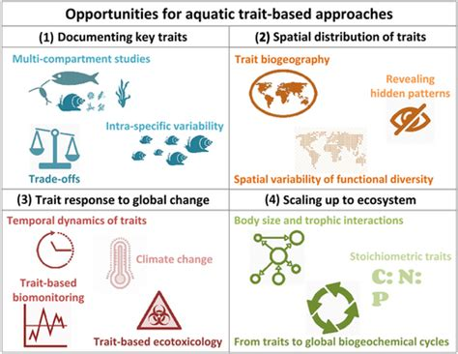
Trait based approach in freshwater fish
Day 4 · Belém · 08 / 20
Trait-Based Ecology — Day 4 · Fish morphological traits (Brosse 2021 FishMorph) · Belém, Brazil

Slide 4
Why morphological traits for fish?
THEORY
Measurable on preserved specimens
Mechanistically linked to function
Taxonomically universal
Photographs · museum specimens · scientific drawings.
No need for live animals — opens up centuries-old collections.
Enables global databases like FishMorph (Brosse 2021) with 8,342 species.
Body shape predicts locomotion performance.
Mouth position and gape predict diet.
Fin shape predicts habitat use. Links experimentally validated.
Same 10 traits work for Amazonian characins AND Asian cyprinids.
Cross-continental, cross-clade comparisons possible.
Comparable from a 3 cm tetra to a 3 m arapaima.
Trait-Based Ecology — Day 4 · Fish morphological traits · Belém, Brazil

Slide 5
FishMorph (Brosse et al. 2021) — the framework
THEORY
A global database of morphological traits for 8,342 freshwater fish species (≈ 49% of world fauna)
Why this framework?
What it covers
How it is built
Standardised across continents and clades.
Same 11 measurements work for a 3 cm tetra and a 3 m arapaima.
Same 10 ratios used in: Toussaint 2016, Su 2019, Brosse 2021…
Open-access data on figshare (DOI: 10.6084/m9.figshare.14891412).
Locomotion
Body shape, fin position, fin shape, peduncle.
Feeding
Mouth size and position, eye size and position, jaw length.
Body size
Maximum body length (FishBase).
Lateral-view photographs / scientific drawings.
Each species: 11 distances measured in ImageJ (in pixels).
Distances combined into 9 unitless ratios + 1 size variable.
→ The result: 10 morphological traits per species.
Day 4 · Belém · 05 / 20
Trait-Based Ecology — Day 4 · Fish morphological traits (Brosse 2021 FishMorph) · Belém, Brazil

Slide 6
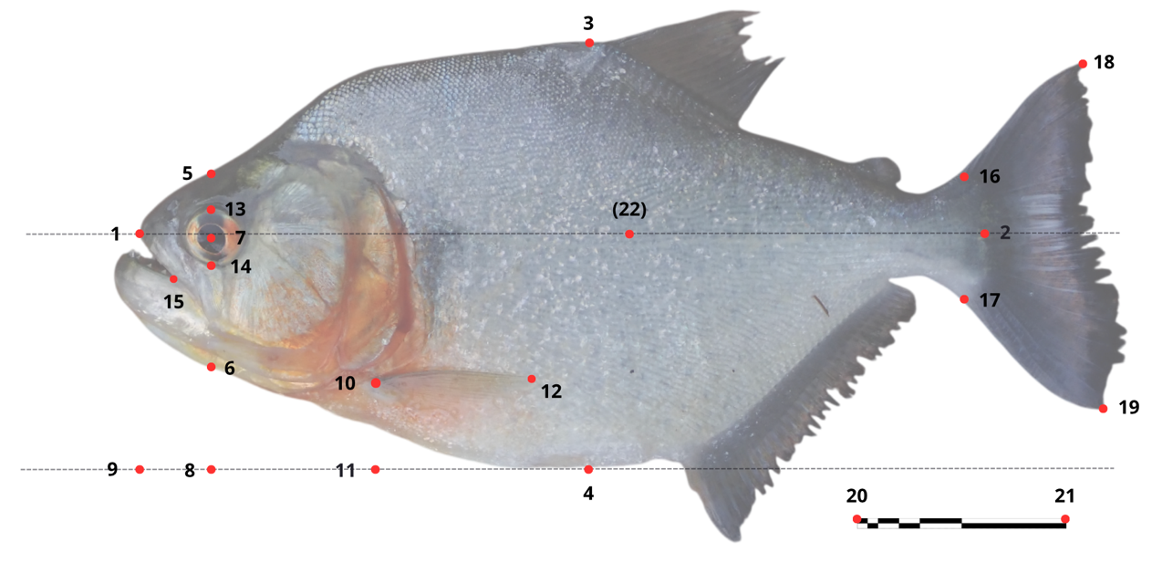
Step 1 — Place the 21 points on a lateral view
STEP 1
Open each lateral-view photo in ImageJ → click 21 points in STRICT order at the specific anatomical landmarks → points 20–21 = 1 cm scale (essential for pixel→mm conversion).
Day 4 · Belém · 06 / 20
Trait-Based Ecology — Day 4 · Fish morphological traits (Brosse 2021 FishMorph) · Belém, Brazil

Slide 7
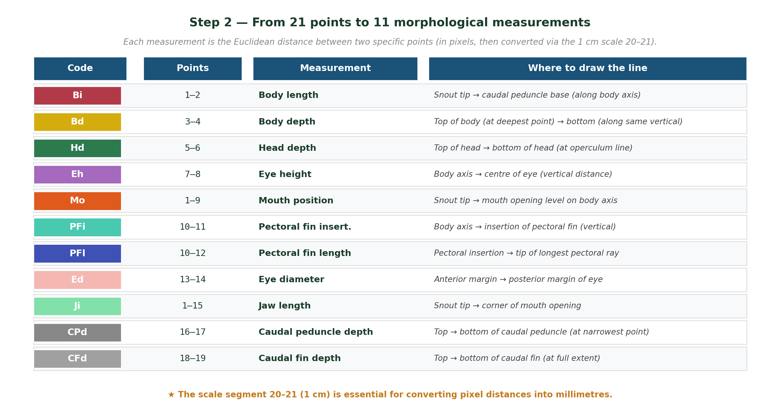
Step 2 — From 21 points to 11 measurements
STEP 2
Convention
All distances expressed in pixels first, then converted to millimetres using the 1 cm scale (points 20–21).
Day 4 · Belém · 07 / 20
Trait-Based Ecology — Day 4 · Fish morphological traits (Brosse 2021 FishMorph) · Belém, Brazil

Slide 8
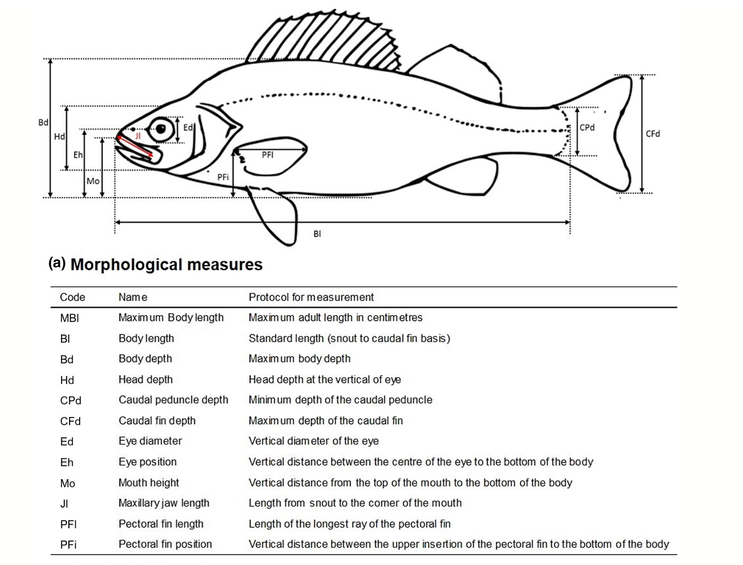
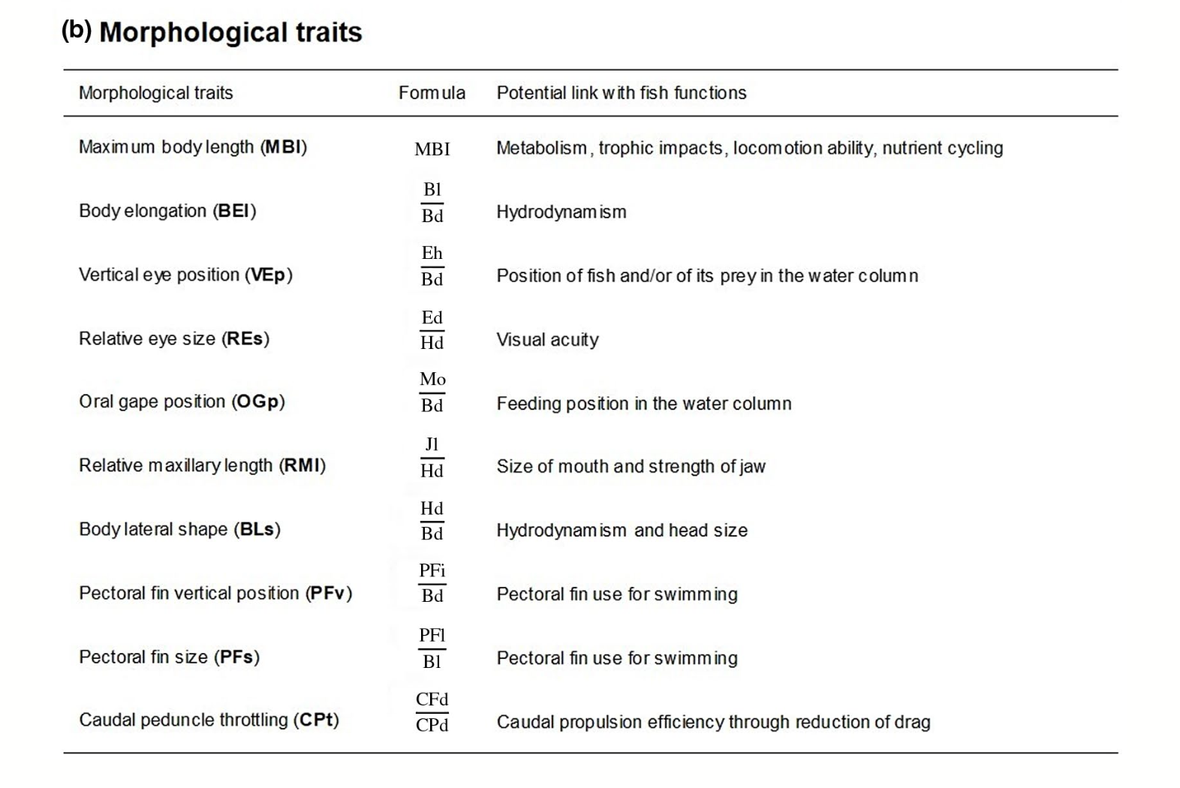
Step 3 — From 11 measurements to 10 traits
STEP 3
Why ratios?
Dividing two distances of the same fish removes body size from the comparison — so a 3 cm tetra and a 3 m arapaima can be compared on the SAME functional space.
Day 4 · Belém · 08 / 20
Trait-Based Ecology — Day 4 · Fish morphological traits (Brosse 2021 FishMorph) · Belém, Brazil

Slide 9
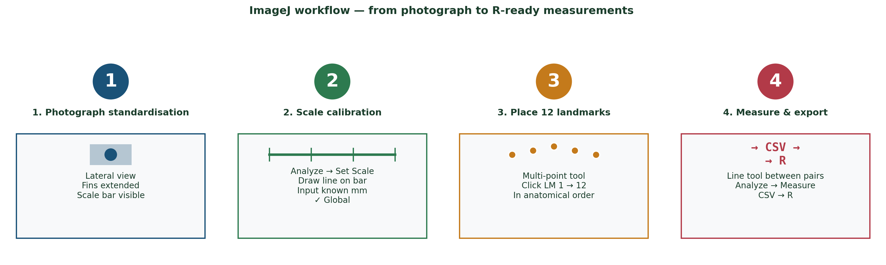
ImageJ workflow — from photo to CSV
PRACTICAL
Critical points along the workflow
• Photographs MUST be lateral, fins extended, scale bar visible.
• Landmarks MUST be placed in strict numerical order — if you skip one, redo all subsequent ones.
• Quality control: re-measure 10% of specimens; ICC > 0.90 expected.
Trait-Based Ecology — Day 4 · Fish morphological traits · Belém, Brazil

Slide 10
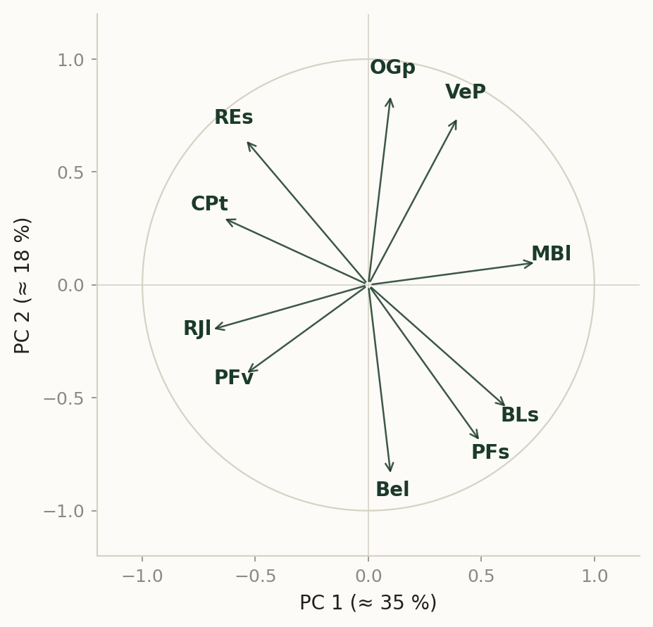
Step 3 — From 11 measurements to 10 traits
STEP 3
First axis loads body-size (MBl) and body-elongation (Bel, BLs) — the locomotion / hydrodynamic axis.
Second axis loads feeding traits (OGp, RJl, REs) — the trophic axis.
On the 5-D version of this space, PFs and CPt split into a third axis (manoeuvrability vs propulsion); always check the Maire mSD diagnostic before truncating to 2-D for plotting.
Why ratios?
Dividing two distances of the same fish removes body size from the comparison — so a 3 cm tetra and a 3 m arapaima can be compared on the SAME functional space.
Day 4 · Belém · 08 / 20
Trait-Based Ecology — Day 4 · Fish morphological traits (Brosse 2021 FishMorph) · Belém, Brazil

Slide 11
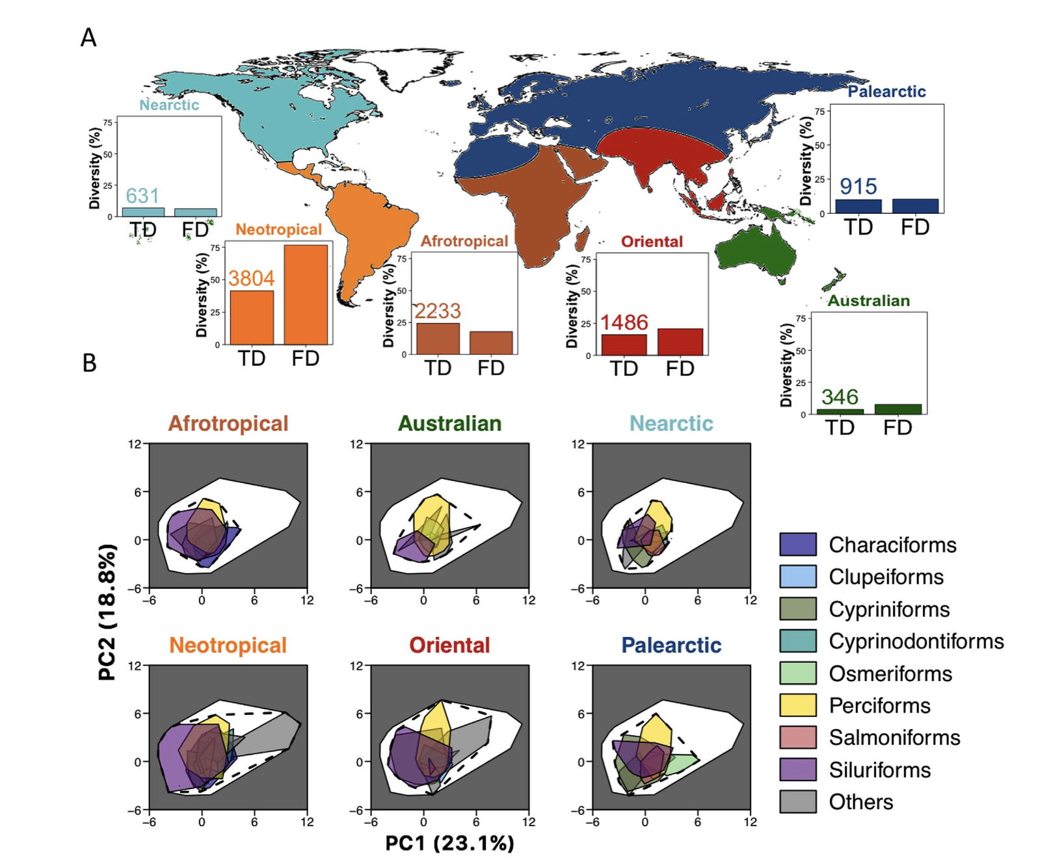
STEP 3
Day 4 · Belém · 08 / 20
Trait-Based Ecology — Day 4 · Fish morphological traits (Brosse 2021 FishMorph) · Belém, Brazil

Slide 12
Why freshwater fish? The Neotropical paradox
MOTIVATION
The Amazon basin is the world's largest concentration of freshwater functional diversity
>10,000
fish species in the Neotropics
≈ 30 % of all vertebrate species on Earth
75 %
of global freshwater FD
concentrated in the Neotropics
≈ 6,000
species in the Amazon basin
more than in all of Europe's rivers combined
This makes the Amazon a critical natural laboratory for testing trait-based hypotheses at global scale.
Trait-Based Ecology — Day 4 · Fish morphological traits · Belém, Brazil

Slide 13
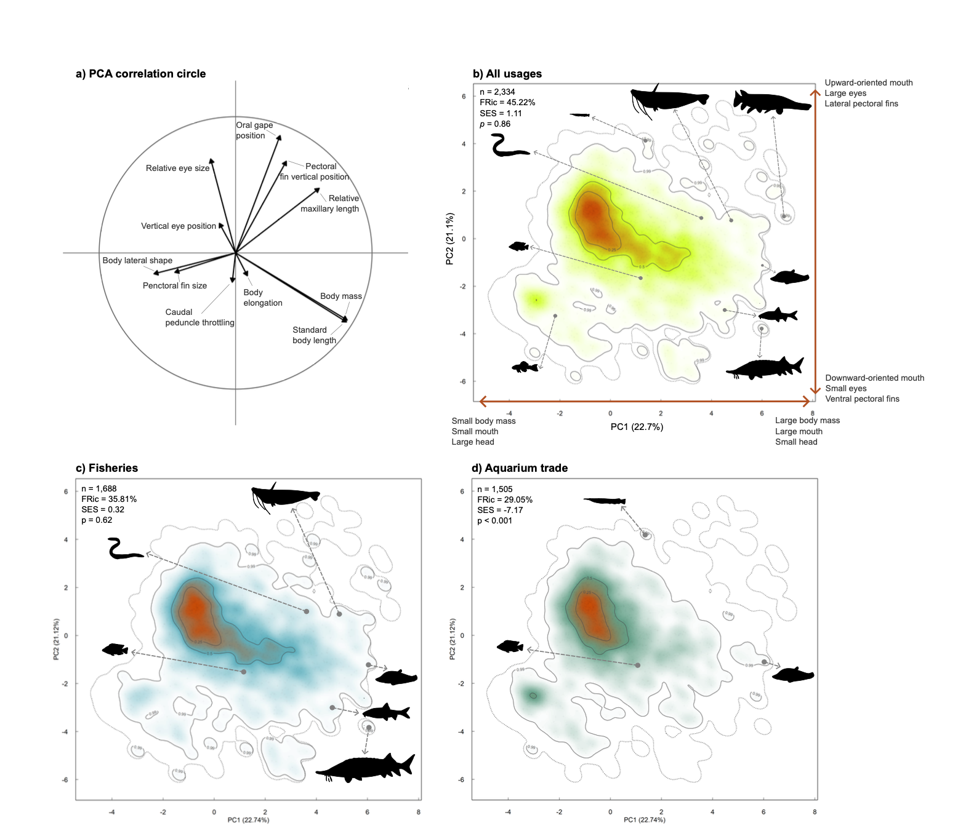
What the type of fish used by humans
PRACTICAL
Trait-Based Ecology — Day 4 · Fish morphological traits · Belém, Brazil

Slide 14
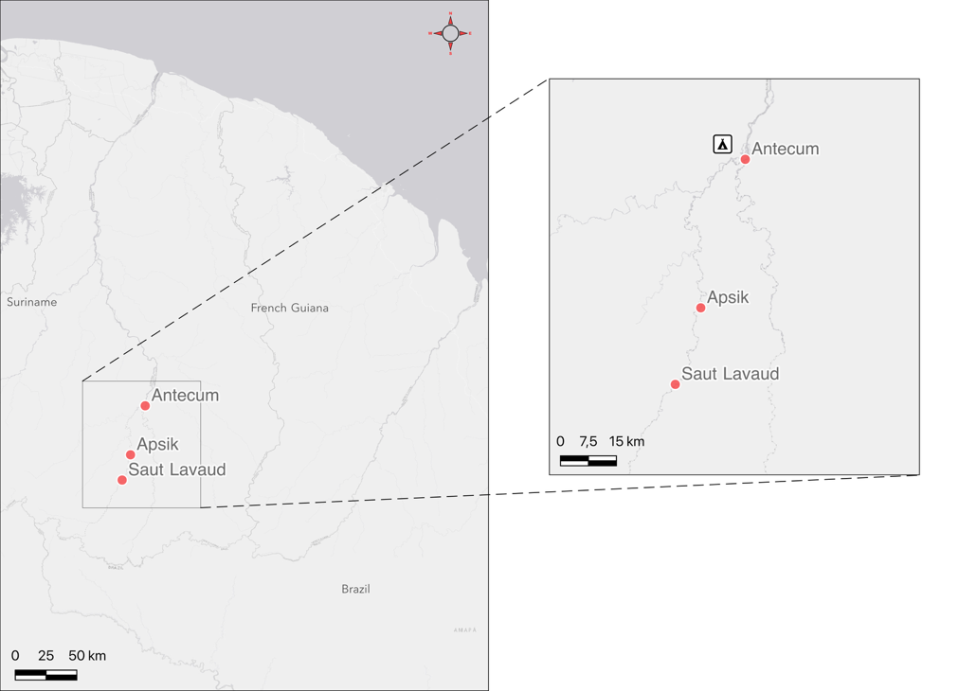
Measure the ITV
PRACTICAL
50 species
1500 individuals
Trait-Based Ecology — Day 4 · Fish morphological traits · Belém, Brazil

Slide 15
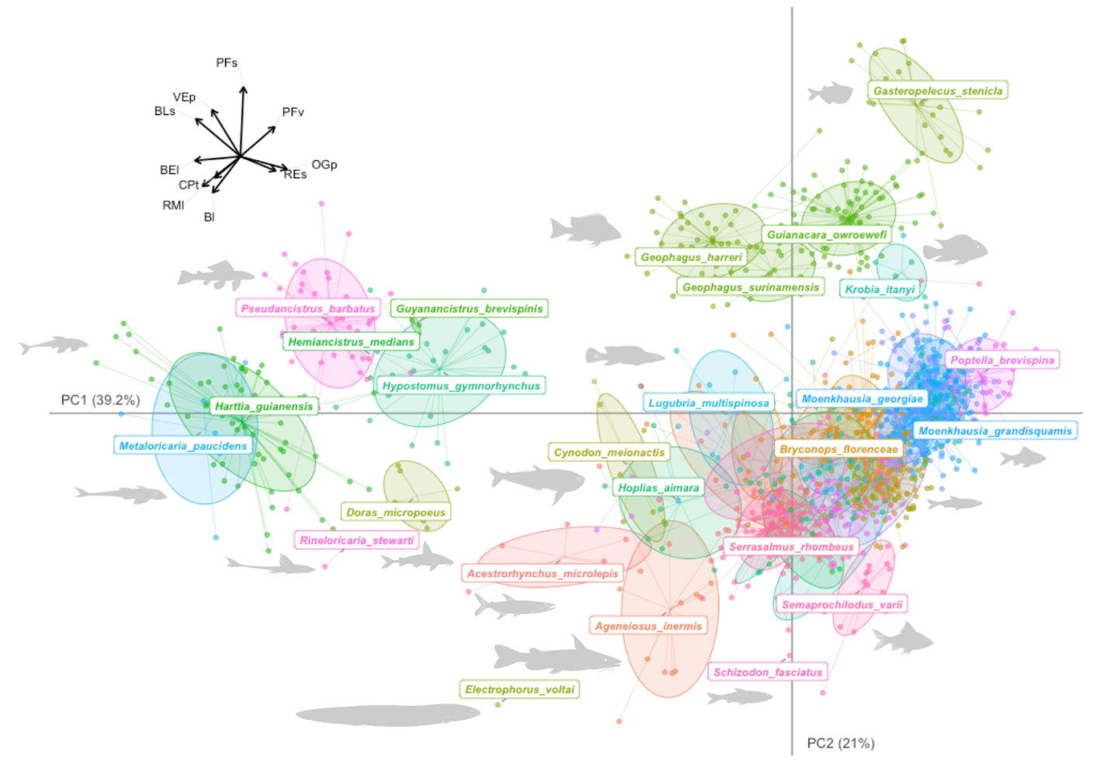
Measure the ITV
PRACTICAL
50 species
1500 individuals
Contribution to community
Trait-Based Ecology — Day 4 · Fish morphological traits · Belém, Brazil

Slide 16
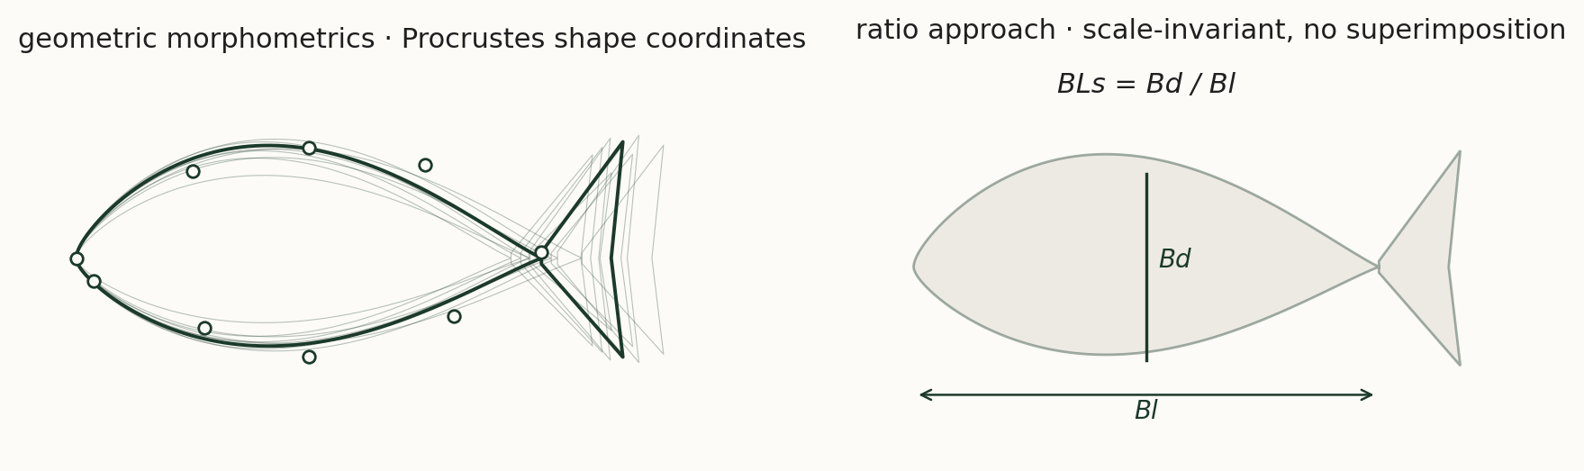
Two morphometric philosophies
PRACTICAL
Geometric morphometrics keeps the full 2-D shape (Procrustes) — more information, requires perfectly comparable poses (Day 5).
Ratios are coarser but robust to pose, fast at scale (8 000+ species) and biologically interpretable line-by-line. Neither dominates — they answer different questions.
Trait-Based Ecology — Day 4 · Fish morphological traits · Belém, Brazil

Slide 17
Quality control — TEM, CV and ICC
PRACTICAL
Technical Error of Measurement (TEM)
Coefficient of Variation (CV)
Intra-Class Correlation (ICC)
TEM = √(Σ(M₁−M₂)² / 2n)
Measure each specimen TWICE. TEM quantifies absolute reproducibility in mm. Low TEM = reliable protocol.
CV = SD / mean × 100
Express measurement error as % of the mean. CV > 5% on a single measurement = re-measure. Soft tissues (MH) typically higher CV.
ICC > 0.90 = excellent reproducibility
{irr::icc} package, two-way agreement model. Standard ichthyological benchmark.
★ Always report TEM and ICC in the methods. Reviewers increasingly require these.
Trait-Based Ecology — Day 4 · Fish morphological traits · Belém, Brazil

Slide 18
Exercices
EXERCISES
Q1 — Measurement quality control
Q2 — Trait–ecology relationships
a) Measure the same fish photograph twice (with a pause between measurements). Compute the TEM (Technical Error of Measurement) and CV for each of the 12 landmark positions.
a) Plot Mouth_pos against Body_elong for all species. Colour points by trophic guild (piscivore / omnivore / invertivore / herbivore / detritivore). Are the guilds separated in this trait space?
b) Which landmark has the highest measurement error? Propose a biological explanation (e.g. soft tissue vs. hard bone, ambiguous anatomical boundary).
b) Compute the correlation matrix between all 10 fish functional traits. Which pair of traits is most strongly correlated? Propose a mechanistic explanation (locomotion–diet trade-off).
c) Compute the intra-class correlation coefficient (ICC) between your two measurement sessions using the {irr} package. Interpret: is the measurement protocol sufficiently reliable (ICC > 0.90)?
c) Using a PCoA of fish functional distances, visualise the Amazonian functional space. Which order of fish occupies the most extreme positions? Which is most central (functionally average)?
Q3 — FD indices across sites
Q4 — From morphology to ecosystem function
a) Compute FRic and FDis for each of the 12 Amazonian fish communities in the dataset. Which site has the highest functional diversity? The lowest?
a) The CWM of Oral_gape is often used as a predictor of top-down predation pressure. Plot CWM(Oral_gape) against a measure of invertebrate biomass (provided in the dataset). Is the relationship significant?
b) Plot FRic and FDis as a function of site degradation index (human impact score). Is there a negative relationship? Is it stronger for FRic or FDis? Why might they respond differently?
b) Calculate FUSE scores for the 30 fish species in the dataset. Which species has the highest FUSE score? Describe its morphology and explain why it is functionally irreplaceable.
c) Compute CWM of Body_elong across sites. Do sites with stronger river currents (high velocity) have higher CWM(Body_elong)? Test this with a Spearman correlation.
c) Discussion (≥150 words): compare the trait-based approach applied to fish (morphological traits) with the approach applied to plants (leaf traits, Day 1–3). What are the unique advantages and limitations of morphological trait measurement?
Day 4 · Belém · 19 / 20
Trait-Based Ecology — Day 4 · Fish Morphological Traits · Belém, Brazil

Slide 19
Take-Home Messages — Day 4
1
Morphological traits of fish are directly linked to locomotion and trophic ecology. The 10 standardised ratios (Villéger et al. 2017) can be measured from photographs and applied consistently across all freshwater fish species worldwide.
2
Landmarks are placed at homologous anatomical positions across all individuals — this is the critical requirement for valid comparison. A misplaced landmark invalidates all subsequent measurements from that individual.
3
All traits are expressed as dimensionless ratios, making them body-size independent. A small tetra and a large arapaima can be compared directly in functional space.
4
The Neotropics host >75% of global freshwater fish functional diversity. Amazon fish communities show remarkable functional disparity — from highly specialised benthic scrapers to large-gape piscivores.
5
FD indices computed from fish morphological traits respond predictably to habitat degradation: deforested rivers show reduced FRic and a shift in CWM toward smaller, generalist body shapes.
Day 4 · Belém · 20 / 20

